Slide 1
NT219- Cryptography
Introduction to Cryptology
PhD. Ngoc-Tu Nguyen
tunn@uit.edu.vn

Slide 2
Outline
Introduction to cryptography courses
Why cryptology?
Syllabus;
Guide for reading textbooks and library;
Policy and course assessment;
Projects;
Labs and guides

Slide 3
Why cryptology?
Cryptology= Cryptography + Cryptanalysis
Secret writing
Try to analysis the codes
to reveal secrets

Slide 4
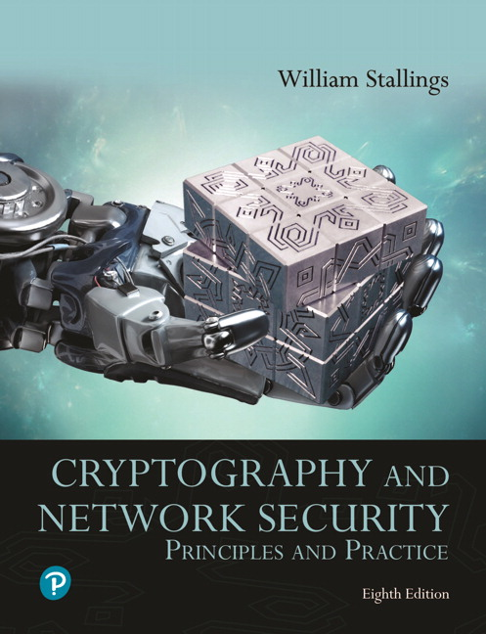
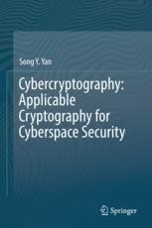
Textbooks and References
Text books
[1] Stallings, W. (2019). Cryptography and network security : principles and practice (8th): Pearson Education
[2] Yan, S. Y.(2019). Cybercryptography: Applicable Cryptography for Cyberspace Security: Springer.

Slide 5
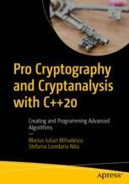
Textbooks and References
Reference books for labs
[3] Mihailescu, M. I., & Nita, S. L. (2021). Pro cryptography and cryptanalysis with C++20: creating and programming advanced algorithms: Apress.

Slide 6
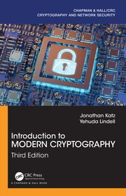
Textbooks and References
Other references
[4] Katz, J., & Lindell, Y. (2020). Introduction to modern cryptography (3rd): CRC press.

Slide 7
Syllabus
Week 1. Introduction to the course
Week 2. Introduction to cryptography
Cryptography overview;
Some terminologies;
Classical cryptography
Week 3,4. Symmetric cryptography
Overview;
Stream cipher (chaotic maps)
Block cipher (DES, AES and mode of operations)
Introduction to some other modern cipher systems

Slide 8
Syllabus
Week 5. Project reports (first time)
Week 6,7,8. Asymmetric cryptography
Overview;
Cryptosystems are bases on factoring problems;
Cryptosystems are bases on discrete logarithm problems;
Elliptic curve cryptosystems
Week 9,10. Hash function and data authentication
Hash functions;
HMAC;
Data integrity;

Slide 9
Syllabus
Week 11. Digital signature
Digital signature
Application
Week 12,13. Applied cryptography
Authentication (Kerberos);
Network security (IPSec; SSL/TLS; SSH);
Database security;
Week 14. Post-quantum Cryptography;
Week 15. Final project report;

Slide 10
Guide for reading textbooks and libraries
Textbooks
[1] Stallings, W. (2019). Cryptography and network security : principles and practice (8th): Pearson Education.
[2] Yan, S. Y.(2019). Cybercryptography: Applicable Cryptography for Cyberspace Security: Springer.
Labs
[3] Mihailescu, M. I., & Nita, S. L. (2021). Pro cryptography and cryptanalysis with C++20: creating and programming advanced algorithms: Apress.
References
[4] Katz, J., & Lindell, Y. (2020). Introduction to modern cryptography (3rd): CRC press.

Slide 11
Guide for reading textbooks and libraries
1. CrypTool 2: https://www.cryptool.org/en/ct2/
2. Crypto++ Library 8.6: https://www.cryptopp.com/
3. C++ Programing Language: Visual Studio Code & MSYS2
https://www.msys2.org/;
https://code.visualstudio.com/
4. Windows and Linux OS:
Windows 7, 10; Ubuntu 20 or Kali Linux
https://www.kali.org/;
https://releases.ubuntu.com/20.04/

Slide 12
Policy and course assessment
1.Attendants: >= 80%;
2. Assignments: Must complete (plus points);
3. Labs: Must complete (home and classroom);
4. CTF: Bonus points
5. Assessments:
+) Process assessment (Project) 30%:
10 (First present)+ 10 (Final present) + 10 (final report);
+) Lab assessment: 30%;
+) Final assessment: 40%
Closed-book wiring exam or oral exam

Slide 13
Projects
1.Project titles: Chosen your-self
2. References and literature survey:
Management papers (Endnote)
Search and download papers
4. Some other guides

Slide 14
Class communication
Google classroom
https://classroom.google.com/
Class code: check your email (studentID@gm.uit.edu.vn)
My email: tunn@uit.edu.vn
Room: E8.6 (Thursday)

